Slide 1


Advertisement
Infographic

Slide 2


Slide 3



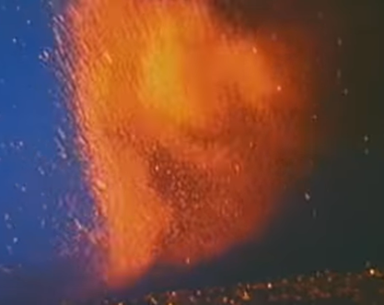


Poster

